Slide 1
IS217 Analytics Foundation
Yang Gao
Assistant Professor of Information Systems
Aug 19-20, 2021

Slide 2
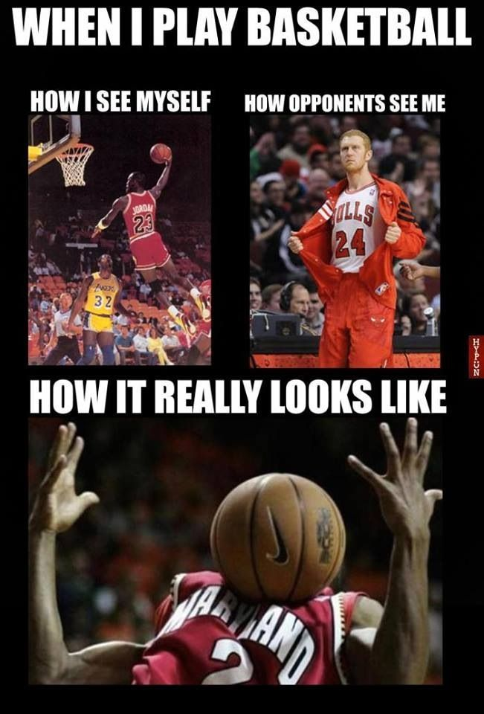

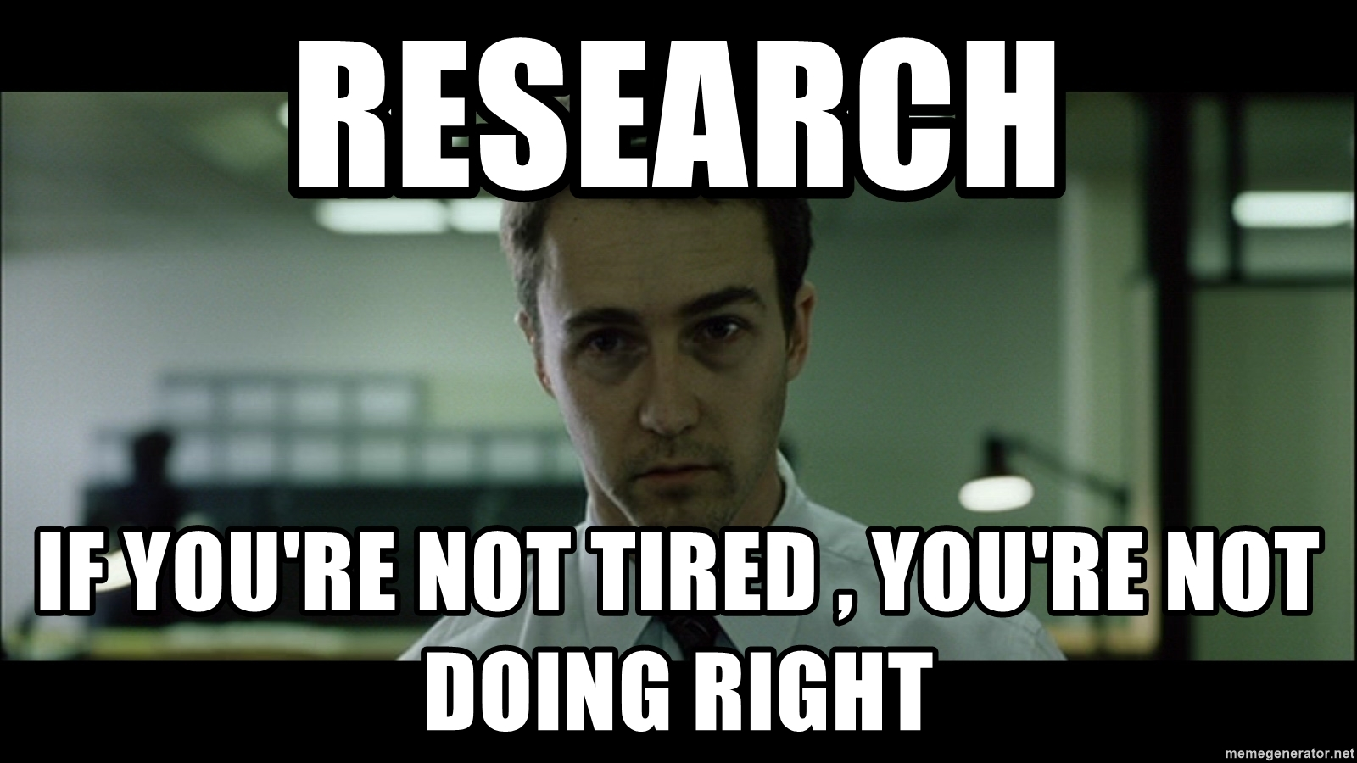

Who am I?
Experiences
Ph.D., Information System, Simon Business School
B.S., Information System, Tianjin University
What I do
Coding
Conducting social media-related research
Playing basketball
Watching movies
… and what I barely do
Using social media (you know why)

Slide 3
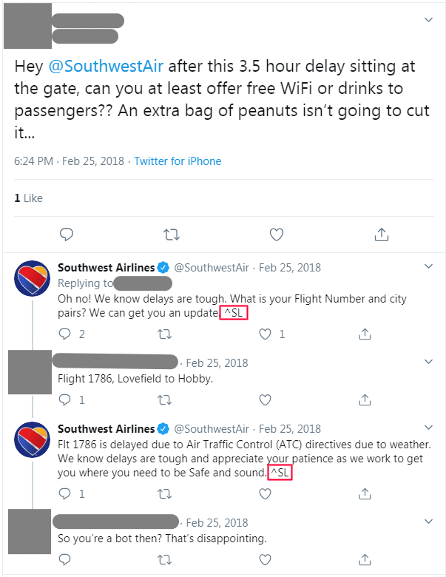
My Research
Business Problem: does active service intervention drive more complaints on social media?

Slide 4
My Research
Data
All tweets posted and received by 40 international airlines from January 2014 to September 2019.
Analytics
Sentiment analysis
Text clustering
Econometrics (e.g., ordinary least square regression)
Business Insights
Active service interventions indeed cause more complaints.
This increase is driven by service awareness rather than chronic complaining.
High quality service reduces future complaints.

Slide 5
So What is Analytics?
When Gartner conducted an informal survey among users about what the term means, the answers ranged from online analytical processing (OLAP) to monitoring call centers to reporting and data mining.
The responses "were completely all over the place and Gartner had more questions than answers after the survey”.
What do you think?

Slide 6
What is Analytics?
Analytics is…
“the extensive use of data, statistical and quantitative analysis, exploratory, predictive models, and fact-based decisions to drive decisions and actions”
— “Competing on Analytics” by Thomas Davenport

Slide 7
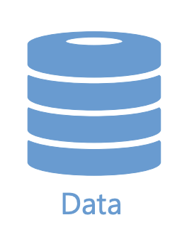
What is Analytics?
Find a business problem
Deploy the model
Collect the data
Evaluate the model
Prepare the data
Create a model

Slide 8
What is Analytics?
Data Science
Data Visualization
Automated Data Driven Decision Making
Machine Learning
Clustering
Classification
Management as a Science
New theories and models
Marketing
Corporate Finance
Operations
Strategy
ANALYTICS
New Data Streams and Databases
Point of Sale
Customer Interaction
Internet of Things
Big Data Technologies
Data Warehousing
Hadoop
No-SQL

Slide 9
Data: the start of it all
Private and Proprietary Sources
Data collected by the organization.
Operational, Transactional / Accounting, Payroll, Sales, Support, etc.
Text — surveys, corporate documents, memos, etc.
Web and social interaction, visits, surveys, etc.
Video, audio, and other multimedia
Data bought from aggregators.
IRI / Nielsen for marketing data
Public Sources
Governments
Other regulatory agencies

Slide 10

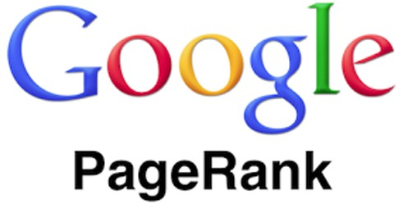














Business Problem Examples
Retail
Search
Coupons
Movie Distribution
Networking
Music
Campaigning
Disruptive companies solving business problem by
Intelligent Applications using Analytics
Advertising
Real Estate
Human Resources
Legal Advice
Dating
Taxis
Wearables
CRM

Slide 11
Data Science is a Scientific Method of Reasoning Applied to Data-driven Decisions
Data wrangling (munging), retrieval + storage
Data mining & machine learning
Hypothesis testing
Experiments
Facts
Logical reasoning
Data engineering
…
Big data
Data Science
Statistics

Slide 12
What is Machine Learning?
Explores Data
Finds Patterns
Predicts (scoring)

Slide 13
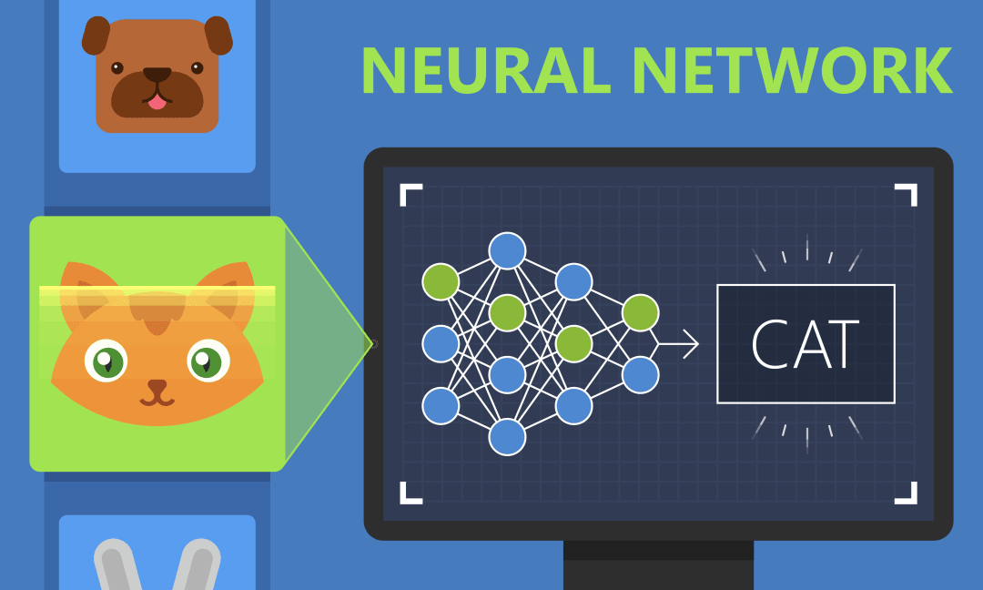
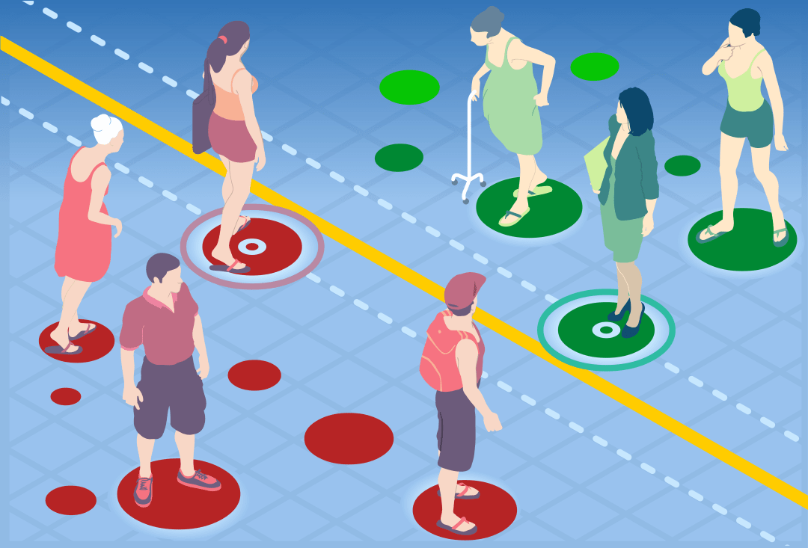
Types of Machine Learning
Supervised Learning — Labeled Data
Classification: predict which class a case belongs to (Is there a cat in the picture?)
Regression: predict numeric outcomes (House prices)
Ensembles: mix the above methods up
Unsupervised — Unlabeled Data
Clustering: discover natural groupings of cases (Customer segments)
Similarities / Recommenders: explore associations, links, and co-occurrence between cases (Guess what customers like)
Reinforcement Learning
Algorithm learns from trial and error which action yields highest rewards (Robotics, gaming, and navigation)

Slide 14
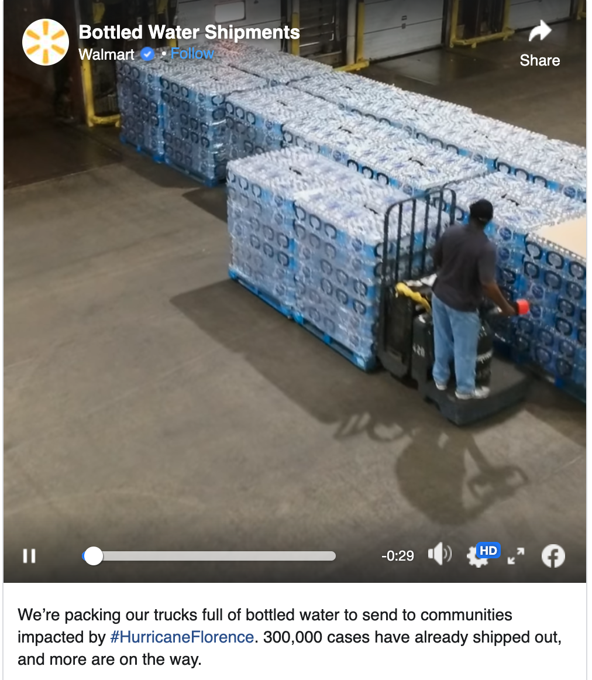
Analytics Examples — Walmart
As hurricane Frances was bearing down on Florida, Walmart’s CIO Linda Dillman asked her staff to analyze data to see if the stocking of stores in the affected areas should be changed in advance of the hurricane.
React before the event, driven by data
Analyze the data from previous hurricanes
Some obvious — stock more bottled water, flashlights
Some not so: How much more?
Discover surprising things: Pop-tarts sales were seven times higher in stores in areas expecting a hurricane.
Walmart has data on 100 million customers, previous purchases
Joined with semi-public information (car ownership, home, etc.)

Slide 15
Reasons for Analytics Popularity
Data availability
Data is being produced.
Data is being warehoused.
Computation availability
Affordable computing power.
Commercial data analytics software are readily accessible.
Organizations are moving from product-based to customer-based.
Strong interests in customer relationship management.
Organizations are becoming “knowledge brokers” since information is a product nowadays.
Supermarkets have information that packaged goods company needs to know.
Credit card companies have information that airlines need to know.
Google sells its knowledge of what people are searching for to sponsored links.

Slide 16
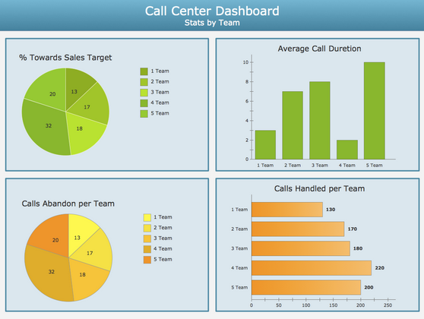
Classification of Analytics Based on Method and Purpose
Descriptive Analytics
Gather, organize, tabulate and depict the characteristics of what is being studied. Historically this type of analytics was referred to as “Reporting”.
Tells you what is happening but nothing about why it is happening or what can be done in the future.

Slide 17
Classification of Analytics Based on Method and Purpose
Predictive Analytics
Go beyond describing the characteristics of the data and the relationship amongst variables.
Use data from the past to predict the future. Use association amongst variables and predict the likelihood of a phenomenon based on the relationships identified.
Example: predict bicycle rentals based on weather and day of the week.
Prescriptive Analytics
Looking at multiple options and strategies and then deciding on the best course of action.
Includes methods such as experimental design and optimization.
Go even further and recommend a course of action.
Example: checking customer responses to loan offers at different price points, then recommending an optimal interest rate based on his/her risk and value profile

Slide 18
Classification of Analytics Based on Field of Application
Marketing Analytics
Operational Analytics
Accounting Analytics
Customer Analytics
Social Media Analytics
Social Analytics
Mobile Analytics
Fraud Analytics
…

Slide 19
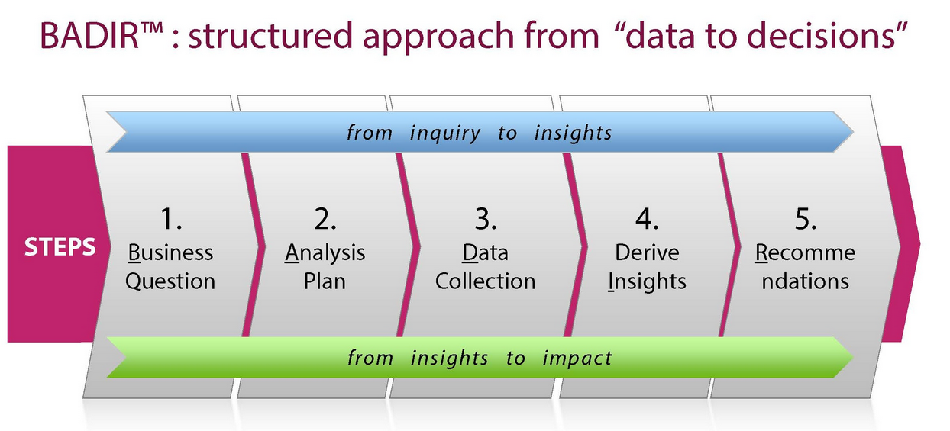
The Framework of Data Driven Solutions

Slide 20
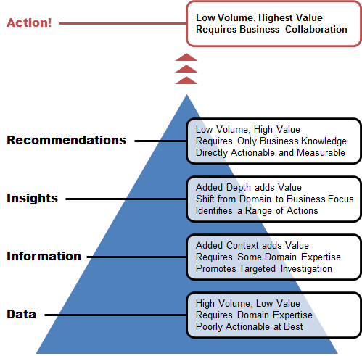
Turning Data into Value
Business Value
Data size

Slide 21
What You will Learn
Advanced Analytics
(Clustering, Regression,
Classification, Association Mining)
Statistical Tools
(Tableau and Python Data Analysis and machine learning libraries and functions )
Data
(Data cleaning, missing data,outliers,transformations)
Statistical Concepts
(Summary Statistics, charts and graphs, distributions, correlations, hypothesis testing)
Visualizations
(Scatter plots, bar charts, histograms, box plots, map graphs)

Slide 22
What You will Learn
Ability to clean data and prepare data for analytics and explore data by using fundamental concepts in Statistics.
Ability to use Python programing language for data analysis and leverage Tableau for data visualization and exploration.
Develop machine learning models covered in the course to discover hidden trends in the data.
Explain the role and significance of Analytics in the Business World via case studies and lab examples.

Slide 23
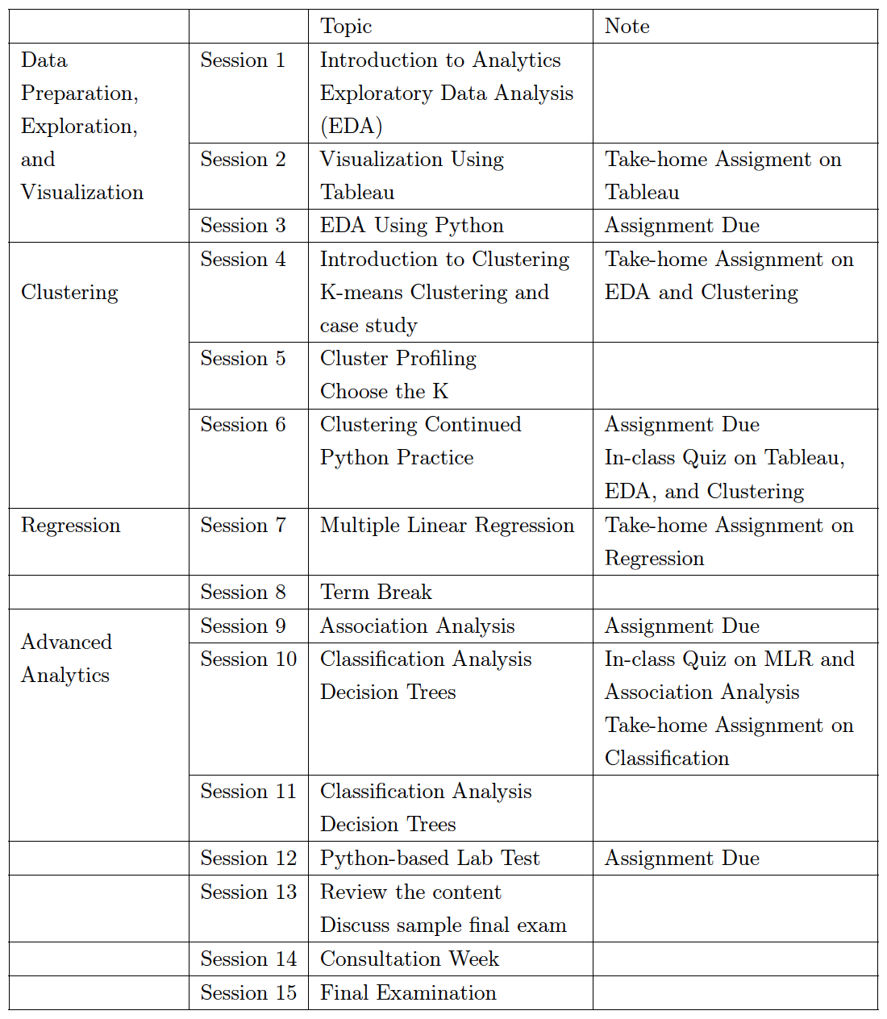
Course Schedule (Tentative)

Slide 24
Grading Scheme
Course Components
Participation
(Includes 4 Elearn based take home assignments)
20%
In Class Quizzes
(20% over 2 quizzes)
Final Exam
45%
Python Test
15%

Slide 25
Class Participation
Attending all the sessions.
Submission of 4 take home assignments account towards class participation.
Positive class participation and interactions with classmates and instructors.
Participation is not limited to class attendance.
Includes sharing your ideas, critical thinking in class and helping your classmates with their learning.
Actively participating in the class discussions.
Helping your peers during in class labs and tasks.

Slide 26
In-class Quizzes and Python Test
There will be 2 quizzes held in class as per the schedule shared in the course document.
Quiz 1 in week 6 on Tableau, EDA, and Clustering.
Quiz 2 in week 10 on Regression and Association Analysis.
These quizzes will have a mix of conceptual and tool-based questions.
Python-based Lab Test
Tentative schedule: 5th November, Friday 4pm – 6pm.
Covers topics before week 12 except for classification.
The purpose of this test is to review the key concepts and help you be more prepared for the final exam.

Slide 27
Final Exam
Purpose of the final examination is to test the learning from all the topics covered during the entire course.
The Final evaluation will be held in week 15.
Questions will be based on all the modules covered during the course.
Questions asked will include MCQ and descriptive questions.

Slide 28
Office Hours
Monday & Tuesday 1:00 – 2:00 pm
Office: Level 4, Room 4061
Zoom meeting ID: 241 424 8378; Passcode: 979971
Appointment upon request
Email: ygao@smu.edu.sg
Email me if you have urgent or quick questions.

Slide 29
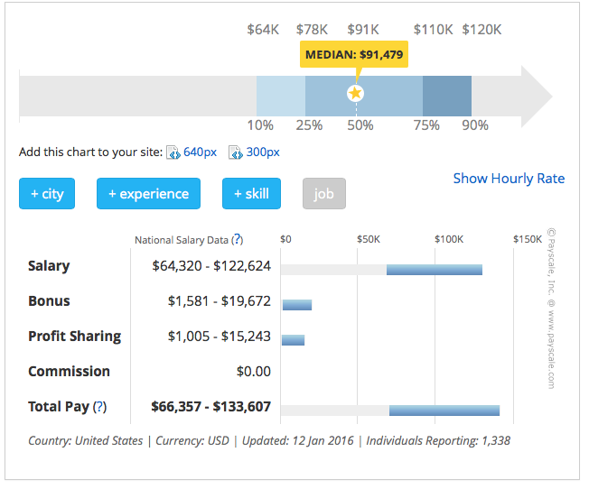
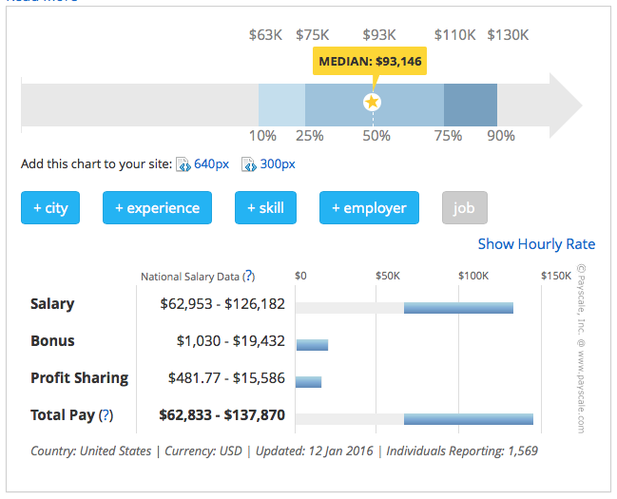
Analytics Related Job Roles
Data and Analytics Manager
Manages a team of analysts and data scientists
Leadership and project management
Interpersonal communication
Data mining and predictive modeling
SQL, R, SAS, Python, Matlab, Java
Data Scientist
Cleans, massages and organizes/leverages (big) data
Distributed computing
Predictive modeling
Storytelling and visualizing
Machine learning, statistics, math
R, SAS, Python, Matlab, Java, SQL, Hive, Pig, Spark

Slide 30
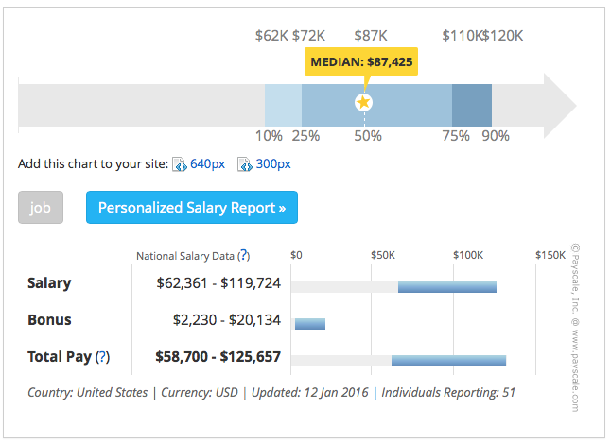
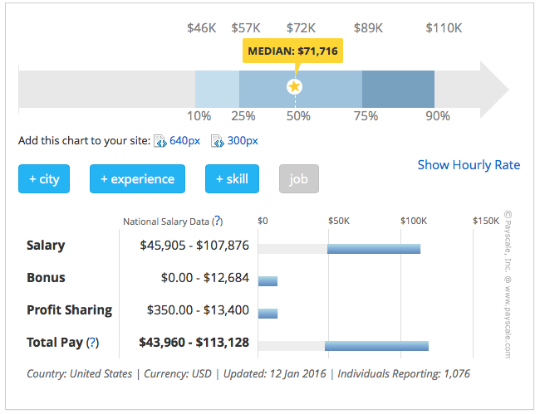
Analytics Related Job Roles
Data Engineer
Develops, constructs, tests and maintains architectures (databases and large-scale processing systems)
Database systems (SQL and noSQL)
Data modeling and ETL tools
Data APIs
Data warehousing
SQL, Hive, Pig, R, SAS, Python, Matlab, Java, Ruby, C++, Perl
Statistician
Collects, analyzes and interprets qualitative and quantitative data using statistical theory and methods
Stat theories and methodologies
Data mining and machine learning
Distributed computing (Hadoop)
Database systems and cloud tools
R, SAS, SPSS, Matlab, Stata, Python, Perl, Hive, Pig, Spark, SQL

Slide 31
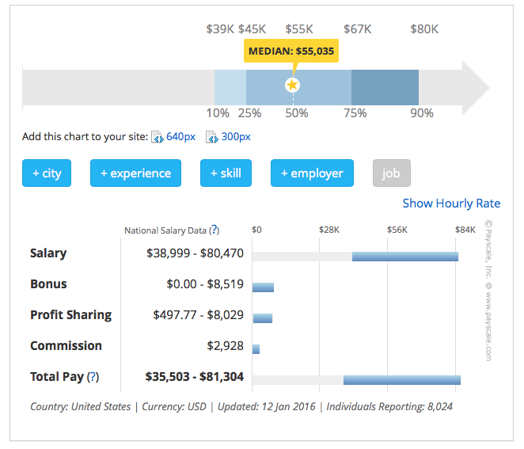
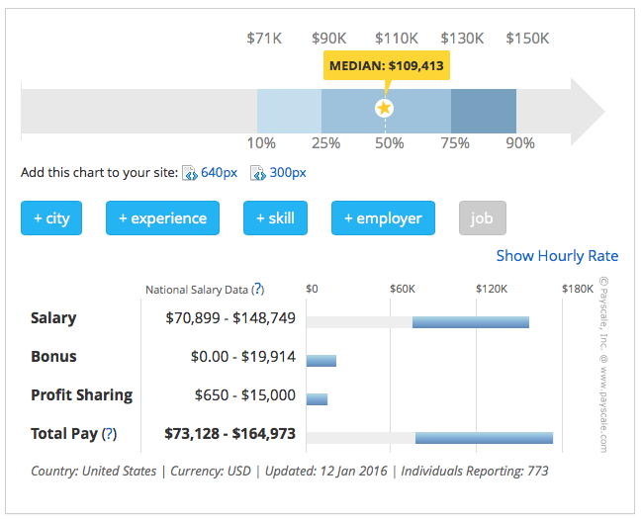
Analytics Related Job Roles
Data Analyst
Collects, processes and performs statistical data analyses
Spreadsheet tools
Database systems (SQL and NoSQL)
Communication and visualization
Math, stats, machine learning
R, Python, HTML, Javascript, C/C++, SQL
Data Architect
Creates blueprints for data management systems to integrate, centralize, protect and maintain data data sources
Data warehouse solutions
In-depth database architecture
ETL tools and data modeling
Systems design and development
SQL, XML, Hive, Pig, Spark

Slide 32
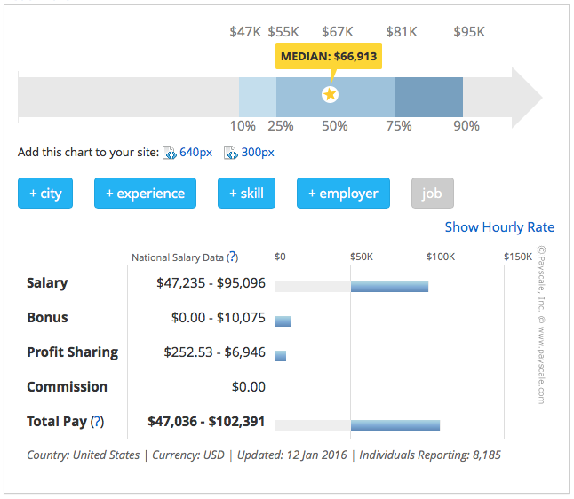
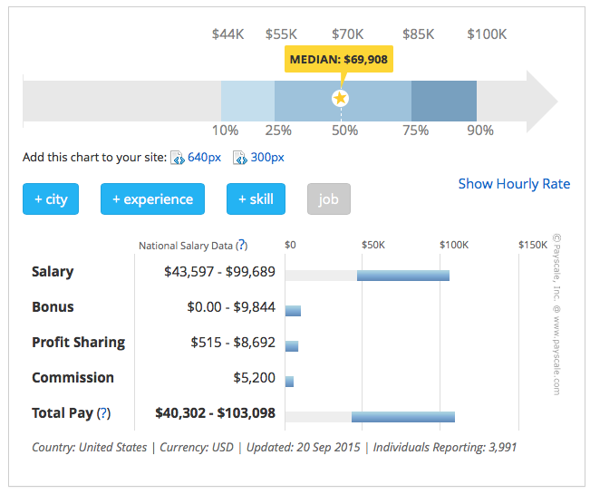
Analytics Related Job Roles
Business Analyst
Improves business processes; an intermediary between business and IT/Analytics
Data visualization tools
Listening and storytelling
Business intelligence
Business process simulation
SQL, conceptual modeling, analytics methodologies
Database Administrator
Ensures database integrity, service levels and security/controls
Backup and recovery
Data modeling and design
Distributed computing (Hadoop)
Data security, ERP and business knowledge
SQL and NoSQL databases
SQL, Java, Ruby on Rails, XML, C#, Python

Slide 33
Summary
Intro of me and the class.
Getting to known what analytics is and why it is becoming popular.

